Slide 1

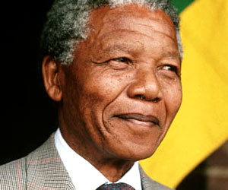
Unit 5 Nelson Mandela
-a modern hero
Pre-reading and Reading

Slide 2
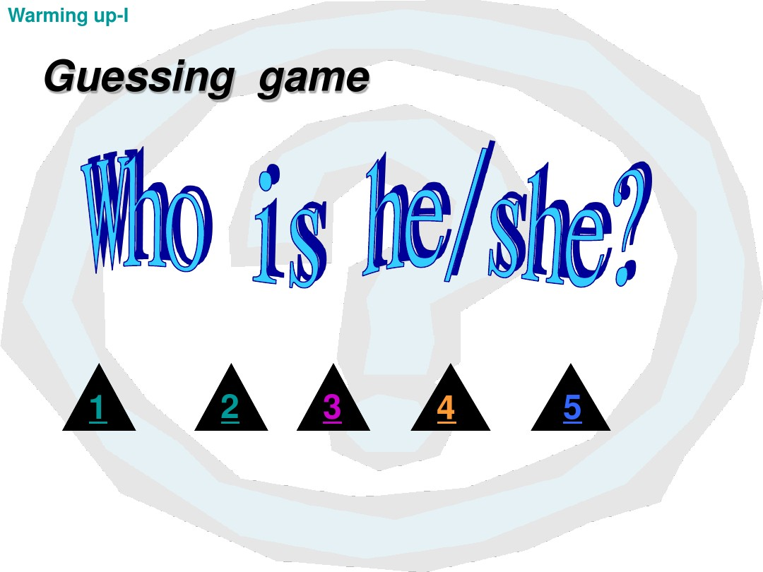

Listen to the background information and guess who he/she is.

Slide 3
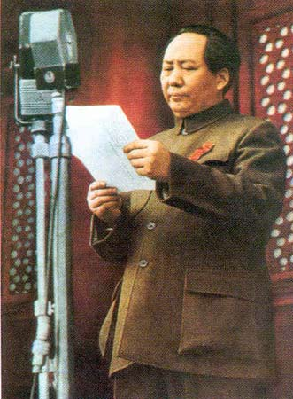
He was the main founder and leader of the Communist Party of China (CPC), and the People’s Republic of China.
He led the Chinese people in liberating themselves.
He was the first Chairman of People’s Republic of China.

Slide 4
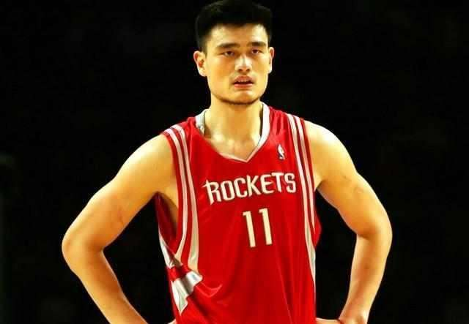
He is one of China’s best-known athletes.
He played for the Houston Rockets of the National Basketball Association (NBA).

Slide 5
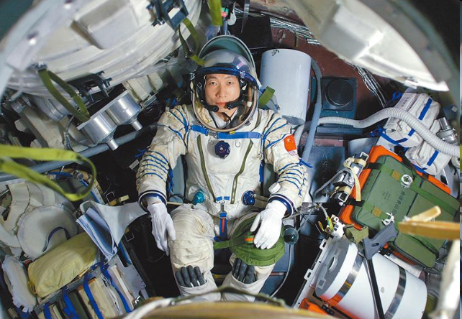
He is an astronaut in China.
He is the first astronaut piloting a spacecraft, traveling in the space on board Shenzhou-5 in 2003.

Slide 6
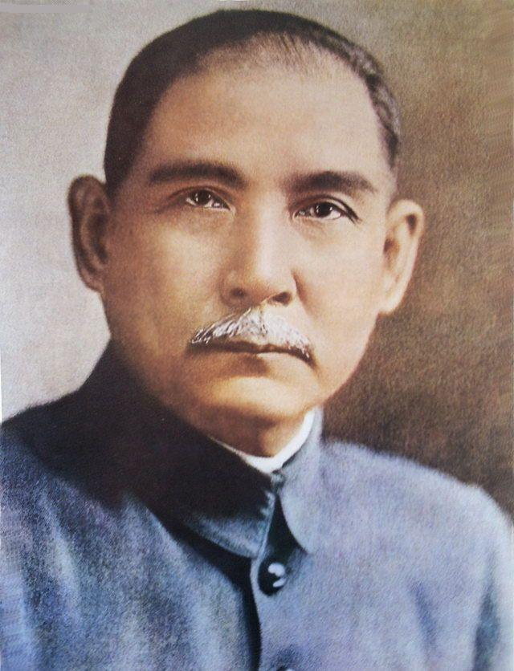
革命的
He was a Chinese revolutionary and political leader.
He is often referred to as the “father of modern China”.
He was the first president when the Republic of China was founded in 1912.
There is a famous university named after him in Guangzhou.

Slide 7
Albert Einstein
He is considered the greatest scientist of the 20th century.
His discoveries and theories have greatly influenced science in many fields.
He received the 1921 Nobel Prize in Physics.
His greatest achievement is the creation of his famous Theory of Relativity.

Slide 8

1. Do you think the people above are great?
2. What qualities do great persons have?

Slide 9

Most great people are also famous people, but famous people may not be great people. A great person is someone who devotes his/her life to helping others. Read the information about these 5 men. Discuss if they were great men. Give reasons.

Slide 10
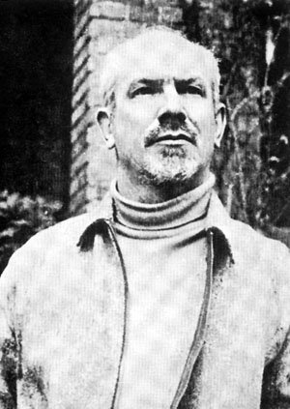
Norman Bethune
(1890 — 1939)
Canada

Slide 11
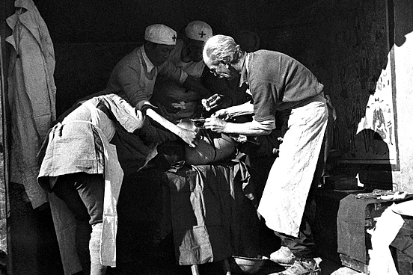
He fought against the German Nazis and Japanese invaders during World War II. He worked selflessly in China as a doctor and saved many Chinese soldiers.

Slide 12
Sun Yat-sen
(1866 — 1925)
China

Slide 13
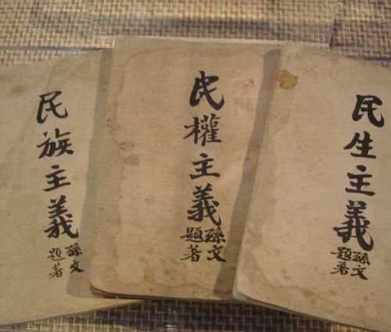
He founded the first Republic in China in 1911 after many years’ fighting. He
strongly believed in the three principles: nationalism; people’s rights; people’s livelihood.

Slide 14
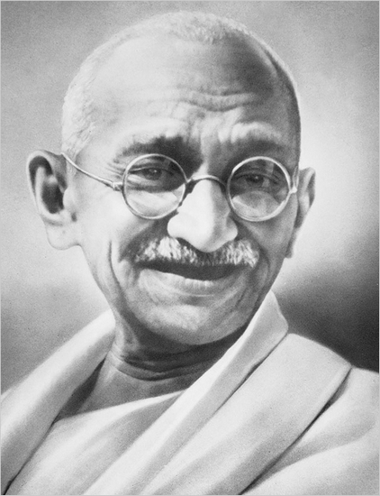
Mahandas Gandhi
(1869—1948)
India

Slide 15
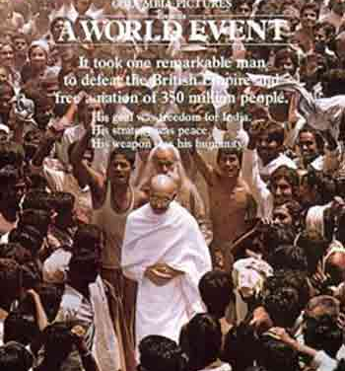
He gave up a rich life for his ideas and fought for his country to be free from the UK in a peaceful way.

Slide 16
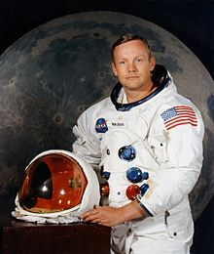
Neil Armstrong
(1930—2012)
USA

Slide 17
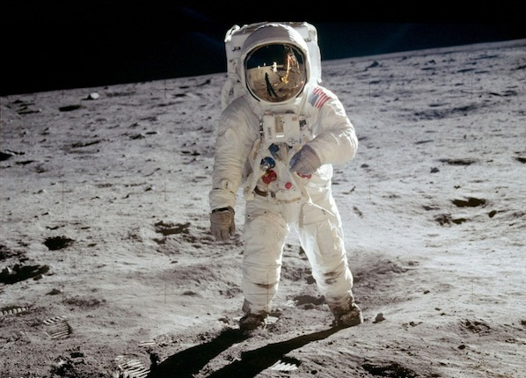
He was the first man to land on the moon in July 1969. He said, “That’s one small step for (a) man, one giant leap for mankind.”

Slide 18
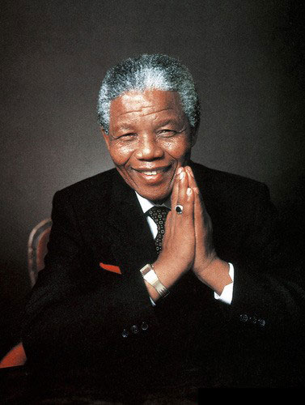
Nelson Mandela
(1918—2013)
South Africa

Slide 19
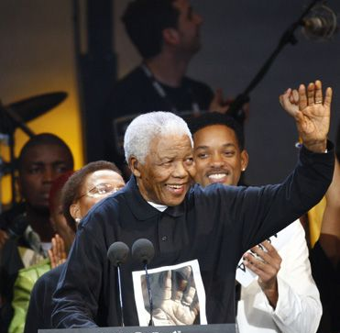
He fought for black people and was in prison for almost thirty years. He helped the black people get the same rights as white people.

Slide 20
Sentence analyses
He strongly believed in the three principles: nationalism; people’s rights; people’s livelihood.
他坚信三条原则：民族，民权，民生。

Slide 21
believe in的用法
1) believe in doing sth.
相信做某事有用，相信做某事是正确的
e.g. They believe in letting children make their own mistakes.
他们相信让孩子犯点错误对他们有益处。
2) believe in sb./sth.
相信，信任 (某人)；信奉 (某物)
e.g. Do you believe in God？ 你信仰上帝吗？
The people want a president they can believe in.
人民想要一个可以信赖的总统。

Slide 22
即学即练
翻译下列句子。
1）虽然他说的话是真的，但我仍然不信任他。
Although _________________, ________ _____________________________.
2) 他相信帮助有困难的人是有益处的。
He believes in _______________________.
his words are true I still don’t believe in him.
helping people who are in trouble

Slide 23
Sentence analyses
He gave up a rich life for his ideas and fought for his country to be free from the UK in a peaceful way.
他为了他的思想而放弃了富裕的生活， 并且用和平的方式为他的国家摆脱英国而进行斗争。

Slide 24
句子短语
1) give up... for... : “为……而放弃……”
2) fight for... : “为……而战”
fight against... : “为反对……而战”
fight with: “和……共同战斗”
3) be free from... : “摆脱……”
4) in a peaceful way: “用和平的方式”

Slide 25
即学即练
用方框中词语的适当形式填空。
give up ,fight for, be free from, in a peaceful way
1) Some people ___________ their own rights, while others ____________ freedom.
2) A lot of measures have been taken to make people__________ poverty ________________.
give up
fight for
free from
in a peaceful way

Slide 26
Sentence analyses
He was the first man to land on the moon.
他是第一个登上月球的人。

Slide 27
即学即练
Mo Yan is the first Chinese to win the Nobel Prize in Literature.
莫言是第一个获得诺贝尔文学奖的中国人。

Slide 28
Take a break!
朗声教育教学测评研究中心研发

